Slide 1
FAMILY CHILD CARE HOME ORIENTATION Viewing Instructions * In the upper toolbar click on “Slide Show” * Click on “From Beginning” in upper left corner * Click on the arrows in the lower right corner to move from slide to slide * Click on the volume icon to begin each slide

Slide 2
FAMILY CHILD CARE HOME ORIENTATION Viewing Instructions * click on the links within the video for additional information * download and print the Certificate of Completion located at the bottom of the last page at the end of this video *A copy of the Pre-service Orientation Certificate of Completion must be submitted to Children’s Services Licensing with your Provisional License Application.

Slide 3
DIVISION OF PUBLIC HEALTH CHILDREN’S SERVICES LICENSING Title 391 NAC Chapters 1 and 2 FAMILY CHILD CARE HOME ORIENTATION
Notes:
Welcome to the Nebraska Department of Health and Human Services, Division of Public Health, Children’s Services Licensing Orientation for Family Child Care Homes. This presentation is part of the required pre-service training to be completed by the applicant/licensee of a family child care home.

Slide 4
Pre-Service Orientation for Family Child Care Homes
Welcome to Family Child Care Home Orientation.
This required pre-service orientation training is a review of the Family Child Care Home regulations.
During this training you will be instructed on how to obtain a Family Child Care Home I or Family Child Care Home II license, as well as what is required of you, the applicant/licensee, and your program.
At the end of this training you, the applicant/licensee, will be able to print the Certificate of Completion for Orientation Training which is required to be submitted with the provisional application packet.
Notes:
This required training is a review of the Family Child Care Home regulations. During this training you will be instructed on how to obtain a Family Child Care Home One or Family Child Care Home Two license.
At the end of this training you, the applicant, will be able to print the Certificate (00:37) of Completion for Orientation Training which is required to be submitted with the provisional application packet.

Slide 5
Differences: Family Child Care Home I & II
FAMILY CHILD CARE HOME I (FCCH I) Must be located in the applicant/licensee’s home where they live. Applicant must be the primary provider. May hire staff, volunteers but ratio and capacity will not change. May be licensed for up to 10 children at one time depending upon total square footage of licensed indoor activity space & outdoor play area, as well as zoning approval in cities where required. Primary provider: a) May care for up to 2 infants with a total of 10 children, however, the 9th & 10th child must be school age. b) May care for up to 3 infants with a total of 8 children, one infant must be 12 months or older. | DIFFERENCES IN LOCATION STAFF CAPACITY RATIOS | FAMILY CHILD CARE HOME II (FCCH II) May be in the applicant/licensee’s home where they live or other location. Note: if the other location is in a residential dwelling the city may require the applicant live at the location of the FCCH II. Applicant may be the primary provider or hire a primary. A second staff may be required to maintain ratios & capacity. May be licensed for up to 12 children at one time depending upon zoning approval and total square footage of licensed indoor activity space & outdoor play area. Primary provider: a) May care for up to 2 infants with a total of 10 children, 9th & 10th child must be school age. b) May care for up to 3 infants with a total of 8 children, one infant must be 12 months or older. Primary provider with staff: c) May care for up to 12 children, if approved by zoning and child care licensing. d) May care for up to 6 infants, every 3rd infant must be 12 months or older.
Note: Provider’s own children count in ratio up to 8 years of age.
See FCCH regulations and ratio chart on the Child Care Licensing Home page.
Notes:
There are two types of Family Child Care Home licenses: A Family Child Care Home One and Family Child Care Home Two. Identifying the differences will help you determine which license type will be appropriate for you.
LOCATION: A Family Child Care Home One is a child care program in the applicant’s home -- the home where you live. A Family Child Care Home Two can be in the applicant’s home or in another location. If the other location will be a residential dwelling, the city may require you, the applicant, to live at the location of the Family Child Care Home Two.
STAFF: You, the applicant of a Family Child Care Home One must be the Primary Provider. You may hire additional staff or volunteers to assist with the care of children, but this will not change the ratio or capacity of the program.
If you, the applicant, apply for a Family Child Care Home Two you may be the primary provider or
hire a primary. Additional staff may be required to maintain ratios and capacity.
CAPACITY: A Family Child Care Home One may be licensed for up to 10 children at one time depending upon total square footage of the licensed indoor activity space and outdoor play area, as well as zoning approval in cities where zoning is required. A Family Child Care Home Two may be licensed for up to 12 children at one time depending upon zoning approval and total square footage of licensed indoor activity space and outdoor play area.
RATIOS:
The primary provider of a Family Child Care Home One or Family Child Care Home Two may be approved to care for up to 2 infants with a total of 10 children at one time, however, the 9th & 10th child must be school age. If only caring for up to 8 children at one time the primary may then care for up to 3 infants but one infant must be at least 12 months of age.
If the Family Child Care Home Two is zoned and licensed to care for up to 12 children at one time, the primary provider and staff may care for up to 12 children, including 6 infants, however, every 3rd infant must be at least 12 months of age. Be aware that the provider’s own children count in ratio up to 8 years of age. For additional information refer to the Family Child Care Home Regulations or ratio chart on the child care licensing home page.

Slide 6
Prior to Provisional Application Submission
Prior to applying for a provisional license ZONING APPROVAL may be required.
Family Child Care Home I (FCCH I): must be submitted ONLY if located in cities that have zoning ordinances for FCCH I’s. Review the Licensing Process Overview for more information.
Family Child Care Home II (FCCH II): all FCCH II’s are required to submit zoning approval.
If the FCCH II is located on the premises of an accredited, approved school, the applicant will
not be required to submit zoning approval. Submit a statement identifying this exemption.
Zoning approval is obtained through the relevant jurisdiction of the FCCH location.
Certificate of Occupancy or
Letter of Approval or other applicable document
Notes:
To assist with your decision on which license type will be a better option for you, review the following Zoning information thoroughly.
Prior to the submission of the application packet the applicant may be required to obtain Zoning Approval.
If applying for a Family Child Care Home One license, review the Licensing Process Overview instruction sheet located on the Child Care Licensing home page, to determine if zoning approval is required for the home address.
All Family Child Care Home II’s are required to obtain and submit a copy of zoning approval for the address to be licensed. If the Family Child Care Home Two will be located on the premises of an accredited, approved school the applicant will not be required to submit zoning approval. Applicant must submit a statement identifying this exemption.
Zoning approval is obtained by contacting the city, county, or township office where the Family Child Care Home facility will be located. Zoning approval documents will vary but must be in the form of a Certificate of Occupancy, Letter of Approval, or other type of document from the applicable office.

Slide 7
Application Process: Provisional
Provisional Application and Documents:
Go to the DHHS Child Care Licensing home page
-Locate and click on “How to Apply for a Child Care or Preschool License”.
Select Step 1 and locate the license type for which applying. You will see the following:
Liability Insurance Memo: required prior to license issuance.
Regulations: the applicant and staff are required to read and understand the regulations
Licensing Process Overview: print and review this document
Review Steps 2, 3, and 4, for additional information
When ready to apply, follow the instructions on the Licensing Process Overview document.
Notes:
Once you have received the Zoning approval, if required for your specific license, you may now complete the application process. (5:07) Start by clicking on the link titled DHHS Child Care Licensing home page located on this slide.
From the home page scroll down to locate and click on the “How to Apply for a Child Care or Preschool License” option at the right of the home page screen. Click on the drop down arrows for Step 1 and select the license type for which you are applying. You will then see the following:
Liability Insurance Memo – proof of activation of Liability Insurance is not required in advance but must be submitted prior to license issuance.
Regulations – the applicant and staff are required to read and understand the regulations.
Licensing Process Overview – used for the application process. Review Steps 2, 3 and 4, for additional information.
When ready to apply, follow the instructions on the Licensing Process Overview document.

Slide 8
Application Process: Provisional -continued
Provisional Application and Documents: Child Care Licensing Forms
All required Child Care Licensing forms are located on the Forms link, on the Child Care Licensing home page, to include:
Application for Family Child Care Home I or II Provisional
Consent and Authorization for Release of Information
Report of Law Enforcement Contact
Health Information Report
Health & Safety: Prepare to Care - Certificate of Completion
Safe with You Training – Certificate of Completion
Child Care Criminal History Check Application - Fingerprinting process
Orientation Certificate of Completion (this training)
Refer to the provisional application instruction sheets for information on who
must complete the required documents.
Notes:
All required licensing forms are located on the Child Care Licensing home page. (6:18) See website link located on this slide.
The required forms include but are not limited to:
the Application for a Family Child Care Home One or Two Provisional license,
Consent and Authorization for Release of Information
Report of Law Enforcement Contact
Health Information Report
Health & Safety: Prepare to Care training - certificate of completion
Child Care Criminal History Check Application for Fingerprinting process, and
the Orientation Certificate completed by the Applicant, (6:52) printed at the end of this training.
Refer to the provisional application instruction sheets for information on who must complete the required documents.

Slide 9
Application Process: Provisional -continued
Provisional Application and Documents: Required Additional Documents
Additional documents will be required. Thoroughly review the Licensing Process Overview, and the list of Required Additional Documentation located with the application.
Zoning Approval, if applicable
National Criminal History Record Checks -- Fingerprinting
CPR and First Aid Certification
Sketch or Diagram of indoor space and outdoor play area showing dimensions/measurements
Proof of Residence - FCCH I only
Fee for Provisional license - $25.00, non refundable
Liability Insurance: coverage and cost quote submitted with application;
not required in advance but must be submitted prior to license issuance.
Notes:
Additional documents will be required. Review the Licensing Process Overview instruction sheet and the list of Required Additional Documentation located with the application.
The additional documents required to be submitted with the application include but are not limited to:
Zoning Approval -- if applicable,
(7:17) National Criminal History Record Checks – Fingerprinting
CPR and First Aid Certification -- submit a copy of certification; if submitting copy of certification card, include front & back,
Sketch or Diagram of facility showing the dimensions (measurements) and arrangement of rooms to be used by children,
Proof of Residence is required only for a Family Child Care Home One, in the form of two documents that will verify the applicant lives at the address where child care will be provided, and
the provisional licensing fee of $25 dollars. This fee is non refundable.
Proof of activation of Liability Insurance is required, however, it does not need to be submitted in advance but must be submitted before the license will be issued.

Slide 10
Application Process: Provisional - continued
Provisional Application and Documents:
Submit all documents together:
Mail documents with fee, OR
Scan and email documents - mail fee separately.
Check or money order only.
Fingerprinting Process:
Do not submit Child Care Fingerprint History Check Applications to DHHS in advance of the Provisional License Application.
Child Care Fingerprint History Check Applications may be submitted with the Provisional License Application. Additional fingerprinting applications may be submitted after the Provisional Application, as needed.
Click Here for Fingerprinting info and Applications
Be sure to keep copies of all documents submitted to the Department.
Notes:
Submit all required documents together.
You may mail the application documents and fee to the DHHS mailing address listed on the application instructions
OR you may scan and email the documents to the DHHS email address listed on the application instructions and mail your fee payment separately to the corresponding office listed on the instructions.
Make the check out to DHHS Children’s Services Licensing. Do not mail cash! Be sure to keep copies of all documents submitted to the Department.
Do not submit Child Care Fingerprint History Check Applications to DHHS in advance of the Provisional License Application. Fingerprinting applications may be submitted with the Provisional License Application. Additional fingerprinting applications may be submitted after the Provisional Application, as needed.
(5/14/20-ADD) (9:13) Refer to the Fingerprint instructions on the Child Care Licensing Home Page.

Slide 11
Application Process: Provisional - continued
Complete Provisional Application Packet Received, Documents Approved
Fire Inspection referral will be sent by the Department.
A fire inspector may contact you to schedule an inspection or stop by unannounced.
The fire inspector will not release an approval without receipt of the fire fee payment, paid to their office.
Fire inspector will determine their fee.
Licensing Inspection will be assigned to a Child Care Inspection Specialist (CCIS).
The CCIS will contact the Applicant to schedule the provisional inspection within 30 days of assignment.
Compliance with regulations is required.
Future inspections will be unannounced.
Notes:
Once a complete packet is received and the application documents approved, the Department will send a fire referral to the applicable fire inspector. A fire inspector may contact you to schedule an inspection or stop by unannounced when they are in your area. Be aware that the fire inspector will not release the fire approval without receipt of the fire fee payment. Cost of the fire inspection will be determined by the fire inspector’s office and must be paid to that office directly.
The licensure inspection will be assigned to a Child Care Inspection Specialist (CCIS) and notification will be sent to you, the Applicant. The CCIS will conduct an on-site inspection to determine compliance with licensing regulations within 30 days of assignment. The Applicant (and Primary Provider of a Family Child Care Home Two) must be present and prepared at the provisional inspection.
The provisional inspection is the only scheduled inspection. All future inspections by the CCIS will be unannounced.

Slide 12
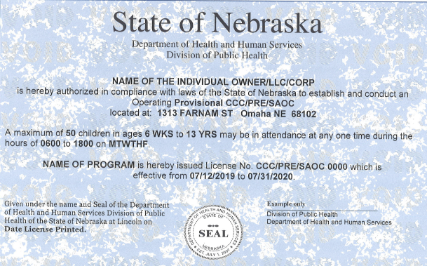
Application Process: Provisional - continued
Provisional License Issuance:
License issuance is usually 30 to 60 days, but may vary.
Before a provisional Family Child Care Home license can be issued the Department must receive:
Proof of activation of Liability Insurance
Approval from the Fire Department, required for:
All Family Child Care Home II’s
Family Child Care Home I’s in certain areas
Fingerprint Eligibility Determination
Approval from Licensing Department
Notes:
The length of time it takes to obtain a Family Child Care Home license will vary, but once a completed application packet is received, it usually takes between 30 and 60 days to complete the licensure process.
Before a provisional Family Child Care Home license can be issued the Child Care Licensing Office must receive:
Proof of activation of Liability Insurance
Fire approval for a Family Child Care Home Two
A Family Child Care Home One in certain areas may require fire approval prior to license issuance
Fingerprint Eligibility Determination
A child care inspection specialist must find the applicant in compliance with Child Care Licensing regulations
The child care inspection specialist will notify the Licensee by phone, mail, or email, of the effective date of the Provisional Family Child Care Home license. You may then begin providing care for 4 or more children at your facility on or after the effective date. The Provisional license will be mailed to the mailing address of the program.

Slide 13
Applications: Provisional to Operating
Provisional to Operating Licensure:
The provisional license expires 12 months after issuance.
An operating license must be issued in order to continue licensed care.
90 days prior to the expiration date of the provisional license an operating renewal packet is sent to the program.
Submit documents and fee to request a non-expiring operating license in a timely manner.
Program will be billed an annual renewal fee thereafter.
Notes:
The provisional license will expire in 12 months.
An operating license must be issued in order to continue licensed care.
About 90 days prior to the expiration of the provisional license an operating license renewal packet will be sent to the program’s mailing address.
A completed operating packet must be submitted in a timely manner. This is to allow enough time for the Department to review the packet and for the provisional to operating license inspection to be completed prior to the expiration date of the provisional license.
When the program has received their operating license they will be billed an annual renewal fee thereafter.

Slide 14
Applications: Amendments
Amendments (changes):
Prior to any changes, the Licensee must submit an amendment to an application within the timelines indicated in regulations.
Some of these amendments include:
change of household members
staff, substitutes, volunteers
hours
days
use of facility
location of premises
Prior to the approval of the amendment, a licensing inspection may be required.
See regulations for details of each amendment and the required
amount of days to submit notification of changes.
Notes:
Prior to any amendment or change to the licensed program, the Licensee is required to submit an Amendment to an Application and applicable documents to the Department within the timelines indicated in regulations.
Some of these amendments include: change of household members, staff, substitutes, or volunteers; hours or days of operation; the use of facility; or location of premises. Prior to the approval of the amendment, a licensing inspection may be required. You cannot move forward with the changes to the license until the amendment has been approved by the Department. For timelines of notification or submission, see regulation “notification of changes”, for details.

Slide 15
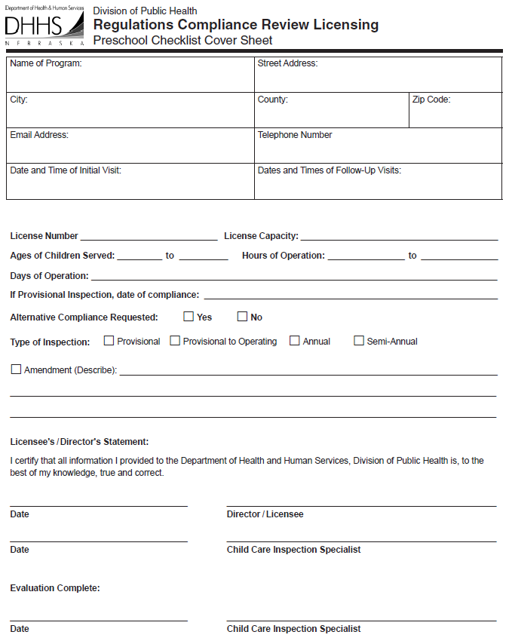
Inspections and Complaint Investigations
Initial Licensure Inspection -- Provisional
Provisional-to-Operating
Annual and Semi-Annual
Follow-up
Monitoring
Complaint
Amendment
Inspections by Other Entities:
Fire Inspection
Sanitation Inspection, if applicable
Notes:
To determine compliance with licensing regulations, the Department will inspect family child care homes as provided under the Nebraska Child Care Licensing Act. There are various types of inspections, however, you will receive a minimum of one inspection annually. See regulations on inspections and complaint investigations for details.

Slide 16
Standards of Operation and Care
Files for the Licensee, Primary, Staff, Volunteer, and Household Member must include the necessary documents to meet the requirements of regulations.
To access regulations click on the Family Child Care Home I or Home II link.
Licensee Qualifications and Requirements
Licensee: owner of the child care program and the individual, partnership, LLC or CORP to whom the license is issued and who is responsible for compliance with all regulations.
Primary Provider, Staff, Volunteer, and Household Member Qualifications and Requirements
Primary Provider: the licensee or a staff member designated by the licensee who is responsible for the daily operation of the child care program.
Staff: an individual who has been hired or approved by the licensee to work or substitute in the child care home and who counts in the staff-to-child ratio.
Volunteer: an individual who assists in the care of children, who does not count in the staff-to-child ratio, and is not left alone with children other than his/her own at the child care home.
Household member: any individual residing in or regularly present in the child care home, including children and youth for whom 24-hour care is provided.
Background Checks, Health Information, Completed Training
Notes:
The Licensee is responsible for the requirements listed in the regulations. See regulations regarding Licensee Qualifications and Requirements for details.
Current staff records, including training documents, must be available for review by a Child Care Inspection Specialist upon request. See regulations regarding the Licensee, Primary Provider, Staff, Volunteer, and Household Member Qualifications and Requirements.

Slide 17
Standards of Operation and Care - continued
To access regulations click on the Family Child Care Home I or Home II link.
Pre-Service Orientation and Training Requirements
Family Child Care Home I Licensee Licensee Licensee Licensee Licensee Licensee Licensee Licensee & Staff (not substitutes or volunteers) | TRAINING Pre-Service Orientation Health & Safety: Prepare to Care Safe with You Training CPR & First Aid Safety Training Business Management NE Early Learning Guidelines 12 hours Annual In-service | Family Child Care Home II Licensee & Primary Provider Licensee & Primary Provider Licensee & Primary Provider Primary Provider Primary Provider Primary Provider Primary Provider Primary Provider & Staff (not substitutes or volunteers)
Although not required, the Department highly recommends all staff obtain Health & Safety: Prepare to Care, CPR & First Aid, and Safety Training.
Notes:
You, the Licensee, the Primary Provider, and staff must complete various required and annual training. This chart is an example of who is required to obtain specific training. Refer to the Family Child Care Home One or Two regulation book for more details.
Documents of completed training requirements must be kept on the licensed premises and made available to the Department upon request.

Slide 18
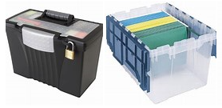
Standards of Operation and Care - continued
To access regulations click on the Family Child Care Home I or Home II link.
Records for the Licensee, Household Members, Primary Provider, Staff, Substitutes, Volunteers, and Children’s files must include the necessary documents to meet the requirements of regulations.
Licensee, Household Member Records
Employee Records Requirements
Child’s Records Requirements
Forms Page
Notes:
Maintaining records is an important part of managing your program. Records for Licensee, Household Members, Employees, and Enrolled Children must be kept current and available to the department. An employee includes: the primary provider, staff, substitutes, and volunteers.
Required records for staff include but are not limited to: completed background checks, required Department forms, and documentation of training. Review family child care home regulations for a complete list of required records.
Required records for children include but are not limited to: completed child’s enrollment record, immunization record, receipt indicating the family received the DHHS Parent Information Brochure, and any signed permission forms. To view and print the Children’s Record form, Parent Information Brochure, Immunization Record form and other documents, click on the forms page link on the Child Care Licensing website.

Slide 19
Standards of Operation and Care - continued
To access regulations click on the Family Child Care Home I or Home II link.
Licensed Capacity:
Indoor activity space divided by 35 square feet
Outdoor play space divided by 50 square feet
Written Policies and Procedures:
Exclusion of children who are ill
Child Development Program info
Diapering Procedures
Disaster Preparedness Plan
For information to assist with these policies see Resources for Licensed
Providers on the child care licensing home page.
Notes:
Licensed Capacity is determined by various factors. Indoor activity space used by the children will be measured and calculated. The total square footage of indoor activity space is divided by 35 square feet per child. The outdoor play area must have a minimum of 50 square feet per child. See regulations for details regarding Licensed Capacity.
The family child care home program must have written policies and procedures available for review upon request.
Written policies and procedures must include but are not limited to:
Exclusion of children who are ill
Information about the Child Development Program
Diapering & Toileting Procedures and
Disaster Preparedness Plan
Refer to family child care home regulations for additional information regarding these policies and procedures. You will find additional information to assist you with these policies located on the Resources for Licensed Child Care Providers link located on the child care licensing home page.

Slide 20
Standards of Operation and Care - continued
To access regulations click on the Family Child Care Home I or Home II link.
Supervision of Children
Discipline
Prohibited Language, Materials, and Actions
Notes:
Adequate and appropriate supervision must be provided to children at all times. Staff must be alert, attentive, and responsive to children’s needs, and protect and remove them from harm.
Facilities are encouraged to have a written behavior management or discipline policy available to staff, parents, and the Department.
Types of discipline that cannot be used in your facility are listed in the regulations. If time out is used, it must be brief and appropriate for the child’s age.
Children should never be exposed to profanity, sexually explicit materials, acts of violence towards a person or animal, or acts of racism.

Slide 21
Standards of Operation and Care - continued
Mandatory Training for the Licensee & Primary Provider!
Health & Safety Training: Prepare to Care
The following regulation topics will be addressed in the ‘Prepare to Care’ training.
Wading and Swimming Activities
Transportation
Medications
Emergency Preparedness
Environmental Services
Environmental Safety
Animals/Pets - See family child care home regulations for details
Notes:
The mandatory Health and Safety Training called Prepare to Care is required to be completed by the Licensee and Primary Provider.
Prepare to Care addresses several regulation topics to include but not limited to: wading and swimming activities, transportation, medications, emergency preparedness, environmental services, and environmental safety. See family child care home regulations for details regarding animals or pets.
(18:11) The link to view and complete the Prepare to Care training is located on the next slide.

Slide 22
Orientation and Health & Safety Training
Certificates of completion to be submitted with the provisional application packet.
Family Child Care Home Orientation: (this training)
To be completed by Applicant/Licensee.
Health & Safety Training: Prepare to Care
To be completed by the Licensee and Primary Provider.
Safe with You Training: Safe Sleep for Infants, Abusive Head Trauma, Power to Protect
To be completed by the Licensee and Primary Provider.
Notes:
(18:18) You will be able to print a certificate of completion at the end of this orientation training. Submit a copy of the Family Child Care Home Orientation certificate and Health & Safety: Prepare to Care certificate with the provisional application packet.
(18:34) When ready, click on the title of the Health & Safety Training to begin and complete that requirement.

Slide 23
Resources
There are several resources that can assist in meeting licensing requirements.
Resources can be located on the Child Care Licensing website on the Information & Resources for Licensed Child Care/Preschool Providers.
Notes:
There are several resources that can assist the program with meeting licensing requirements. These resources can be located on the Child Care Licensing home page.
(18:50) Click on the Information & Resources for Licensed Child Care/Preschool Providers to access the home page.

Slide 24
Lindsy Braddock
Program Manager II
Children’s Services Licensing
Division of Public Health
DHHS.ChildCareLicensing@nebraska.gov
402-471-3121
Download the certificate here
Visit the DHHS social media pages at the links below.
Notes:
ADD: Thank you for choosing to care for the children of Nebraska!

